Slide 1
Automating Vertex AI Workbench Instance Creation with Terraform and GitHub Actions
Objective:
- Each instance will be owned by a specific user, identified by their email.
Create Vertex AI Workbench instances for 10 users using Terraform.
Automate instances creation process by utilizing GitHub actions

Slide 2
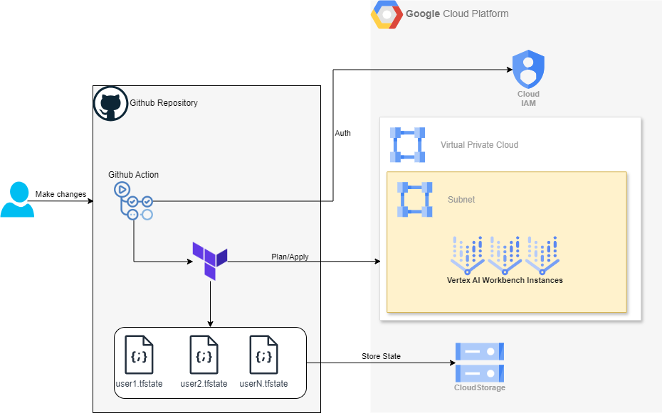
Infrastructure diagram

Slide 3
Key Components:
1. Vertex AI Workbench Instances
Count: 10 instances
User-Specific Ownership: Each instance is assigned to a specific user based on their email
2. Terraform
Configuration: Centralized Terraform scripts to define the Networking infrastructure for the instance and Vertex AI Workbench instance setup.
Parameters: Utilizes user email and some other attributes as a parameter to customize each instance
3. User Configuration Files
tfvars Files: 10 separates files, one for each user, containing user-specific configuration
4. Terraform State Management
Separate State Files: Each user’s instance has its own Terraform state file to ensure isolated and conflict-free management
5. Automation with GitHub Actions:
Job Execution: Automates the creation process
Continuous Integration: Ensures consistent and repeatable deployment processes

Slide 4
Advantages
1. Automation:
Efficiency: Automating the creation of Vertex AI Workbench instances with Terraform and GitHub Actions significantly reduces manual effort and time required for provisioning resources.
Consistency: Ensures a standardized and repeatable process for instance creation, reducing the likelihood of human error.
2. Scalability:
Ease of Expansion: The setup can be easily scaled to accommodate more users by adding additional .tfvars files or adjusting the automation scripts.
Flexible Management: Separate state files and configurations for each user allow for flexible and independent instance management.
3. Version Control and Collaboration:
GitHub Actions Integration: Using GitHub Actions for automation leverages version control, making it easy to track changes, collaborate with team members, and roll back to previous versions if needed.
CI/CD Practices: Integration with GitHub Actions promotes best practices in continuous integration and continuous deployment (CI/CD), improving the overall development workflow.

Slide 5
Limitations
1. Scalability Concerns:
Managing a large number of tfvars files manually can become cumbersome as the number of user grows
GitHub Actions Workflow Complexity: The workflow may become complex and harder to mange with a significant increase in users
2. Resource Management:
Quota Limits: bringing all instances to one project might not available since a cloud project have limited quotas for the resources being provisioned
3. Maintenance:
Terraform State Management: Managing multiple state files can be complex, especially when performing updates or rollbacks

Slide 6
Thanks for watching

